Slide 1
Unit 1
Introduction: Definition, Historical developments, Computing platforms and technologies. Principles of Parallel and Distributed Computing: Parallel versus distributed computing, Elements of parallel computing, Elements of distributed computing, Technologies for distributed computing.

Slide 2
Introduction
Computing is being transformed into a model consisting of services that are commoditized and delivered in a manner similar to utilities such as water, electricity, gas, and telephony.
In such a model, users access services based on their requirements, regardless of where the services are hosted.
Several computing paradigms, such as grid computing, have promised to deliver this utility computing vision. Cloud computing is the most recent emerging paradigm promising to turn the vision of “computing utilities” into a reality.

Slide 3
The Vision of Cloud Computing:
Cloud computing allows anyone with a credit card to provision virtual hardware, runtime environments, and services.
These are used for as long as needed, with no up-front commitments required.
The entire stack of a computing system is transformed into a collection of utilities, which can be provisioned and composed together to deploy systems in hours rather than days and with virtually no maintenance costs.

Slide 4
The Vision of Cloud Computing:
Despite its evolution, the use of cloud computing is often limited to a single service at a time or, more commonly, a set of related services offered by the same vendor.
Previously, the lack of effective standardization efforts made it difficult to move hosted services from one vendor to another.
The long-term vision of cloud computing is that IT services are traded as utilities in an open market, without technological and legal barriers.
In this cloud marketplace, cloud service providers and consumers, trading cloud services as utilities, play a central role.

Slide 5
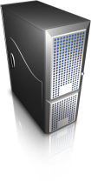













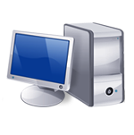

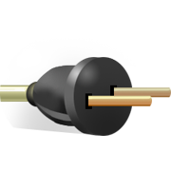




I need to grow my infrastructure, but I do not know for how long…
I have a lot of infrastructure that I want to rent …
I have a surplus of infrastructure that I want to make use of
I cannot invest in infrastructure, I just started my business….
I have infrastructure and middleware and I can host applications
I want to focus on application logic and not maintenance and scalability issues
Global Cloud Marketplace
I have infrastructure and provide application services
I want to access and edit my documents and photos from everywhere..

Slide 6

Definition of Cloud?
No capital investments
Cloudbusrting
SaaS
Quality of Service
Pay as you go
Internet
PaaS
Green computing
IaaS
Billing
Utility computing
Elasticity
IT outsourcing
Service Level Agreement
Virtual Datacenters
Scalability
IT outsourcing
Privacy & Trust
Provisioning
on demand
Security
Cloud Computing?
Virtualization

Slide 7
National Institute of Standards and Technology (NIST): Definition
Cloud computing is a model for enabling ubiquitous, convenient, on-demand network access to a shared pool of configurable computing resources (e.g., networks, servers, storage, applications, and services) that can be rapidly provisioned and released with minimal management effort or service provider interaction.

Slide 8
A Closer Look
Large enterprises can offload some of their activities to cloud-based systems.
Small enterprises and start-ups can afford to translate their ideas into business results more quickly, without excessive up-front costs.
System developers can concentrate on the business logic rather than dealing with the complexity of infrastructure management and scalability.
End users can have their documents accessible from everywhere and any device.

Slide 10









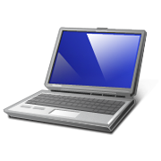
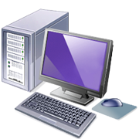
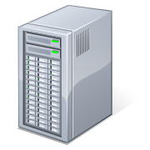



Public Clouds
Applications
Development and Runtime Platform
Compute
All users, on any device
Storage
Cloud Manager
Private Resources
Private Cloud
Private Cloud (Government)
Organization Personnel
Government Agencies

Slide 11
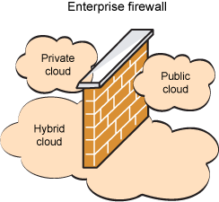
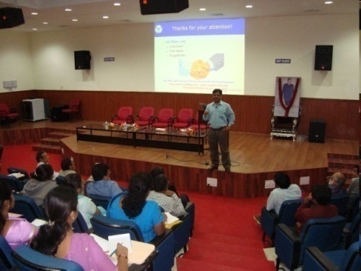

Cloud Deployment Models
Public/Internet Clouds
Private/Enterprise Clouds
Hybrid/Inter Clouds
* 3rd party, multi-tenant Cloud
infrastructure & services:
* available on subscription basis to all.
* A public Cloud model within a company’s own Data Center / infrastructure for internal and/or partners use.
* Mixed usage of private and public Clouds: Leasing public cloud services when private cloud capacity is insufficient

Slide 12
Community cloud:
The cloud infrastructure is provisioned for exclusive use by a specific community of consumers from organizations that have shared concerns (e.g., mission, security requirements, policy, and compliance considerations).
It may be owned, managed, and operated by one or more of the organizations in the community, a third party, or some combination of them, and it may exist on or off premises.

Slide 13
Cloud Computing Reference Model:
A fundamental characteristic of cloud computing is the capability to deliver, on demand, a variety of IT services that are quite diverse from each other.
This variety creates different perceptions of what cloud computing is among users. Despite this lack of uniformity, it is possible to classify cloud computing services offerings into three major categories:
Infrastructure-as-a-Service (IaaS)
Platform-as-a-Service (PaaS)
Software-as-a-Service (SaaS).

Slide 14












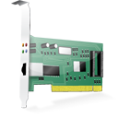
Web 2.0 Interfaces
Software as a Service
End user applications
Scientific applications
Office automation, Photo editing,
CRM, and Social Networking
Examples: Google Documents, Facebook, Flickr, Salesforce
Platform as a Service
Runtime Environment for Applications
Development and Data Processing Platforms
Examples: Windows Azure, Hadoop, Google AppEngine, Aneka
Infrastructure as a Service
Virtualized Servers
Storage and Networking
Examples: Amazon EC2, S3, Rightscale, vCloud

Slide 15
Essential Characteristics:
On-demand self-service
A consumer can unilaterally provision computing capabilities such as server time and network storage, as needed automatically without requiring human interaction with each service provider.
Broad network access
Capabilities are available over the network and accessed through standard mechanisms that promote use by heterogeneous thin or thick client platforms.
Resource pooling
The provider’s computing resources are pooled to serve multiple consumers using a multi-tenant model, with different physical and virtual resources dynamically assigned and reassigned according to consumer demand.

Slide 16
Rapid elasticity
Capabilities can be elastically provisioned and released, in some cases automatically, to scale rapidly outward and inward commensurate with demand.
Measured service.
Resource usage can be monitored, controlled, and reported, providing transparency for both the provider and consumer of the utilized service.

Slide 17
Challenges of Cloud Computing
Cloud computing is not an exception and new interesting problems and challenges are regularly being posed to the cloud community, including IT practitioners, managers, governments, and regulators.
Besides the practical aspects, which are related to configuration, networking, and sizing of cloud computing systems, a new set of challenges concerning the dynamic provisioning of cloud computing services and resources arises.
Security in terms of confidentiality, secrecy, and protection of data in a cloud environment is another important challenge.

Slide 18
Historical Development
2010: Microsoft Azure
1970: DARPA’s TCP/IP
1999: Grid Computing
1984: IEEE 802.3
Ethernet & LAN
1997: IEEE
802.11 (Wi-Fi)
2008: Google
AppEngine
1966: Flynn’s Taxonomy
SISD, SIMD, MISD, MIMD
1989: TCP/IP
IETF RFC 1122
2007: Manjrasoft Aneka
1969: ARPANET
1951: UNIVAC I, First Mainframe
1984: DEC’s
VMScluster
2005: Amazon
AWS (EC2, S3)
1975: Xerox PARC
Invented Ethernet
2004: Web 2.0
Clouds
1990: Lee-Calliau
WWW, HTTP, HTML
Grids
1960: Cray’s First Supercomputer
Clusters
Mainframes
1950
1960
1970
1980
1990
2000
2010

Slide 19
Three Major Milestones:
Distributed systems often exhibit other properties such as heterogeneity, openness, scalability, transparency, concurrency, continuous availability, and independent failures.
Mainframes: Large computational facilities leveraging multiple processing units. Even though mainframes cannot be considered as distributed systems, they offered large computational power by using multiple processors, which were presented as a single entity to users.
Clusters: An low-cost alternative technological advancement to the use of mainframes and super computers. (parallel and high performance computing)
Grids: proposed a new approach to access large computational power, huge storage facilities, and a variety of services.

Slide 20
Virtualization:
Virtualization is another core technology for cloud computing. It encompasses a collection of solutions allowing the abstraction of some of the fundamental elements for computing, such as hard-ware, runtime environments, storage, and networking.

Slide 21
Computing platforms and technologies
Amazon web services (AWS)
Google AppEngine
Microsoft Azure
Hadoop
Force.com and Salesforce.com

Slide 22
Eras of Computing
Architectures
Two fundamental and dominant models of computing are sequential and parallel.
The sequential era began in the 1940s, and Parallel( and distributed)
computing era followed it within a decade.
Four key elements of computing developed during three eras are
Architecture
Compilers
Applications
Problem solving environments
The computing era started with development in hardware architectures, which actually enabled the creation of system software – particularly in the area of compilers and operating systems – which support the management of such systems and the development of applications.
Sequential Era
Compilers
Applications
Problem Solving Environments
Architectures
Compilers
Parallel Era
Applications
Problem Solving Environments
1940
1950
1960
1970
1980
1990
2000
2010
2020
2030

Slide 23
Parallel vs. distributed computing
The terms parallel computing and distributed computing are often used interchangeably, even though they mean slightly different things.
The term parallel implies a tightly coupled system, whereas distributed refers to a wider class of system, including those that are tightly coupled.

Slide 24
Parallel v.s. Distributed Systems
 | Parallel Systems | Distributed Systems
Memory | Tightly coupled shared memory UMA, NUMA | Distributed memory Message passing, RPC, and/or used of distributed shared memory
Control | Global clock control SIMD, MIMD | No global clock control Synchronization algorithms needed
Processor interconnection | Order of Tbps Bus, mesh, tree, mesh of tree, and hypercube (-related) network | Order of Gbps Ethernet(bus), token ring and SCI (ring), myrinet(switching network)
Main focus | Performance Scientific computing | Performance(cost and scalability) Reliability/availability Information/resource sharing

Slide 25
Elements of Parallel Computing
1. What is Parallel Processing?
2. Hardware Architecture for Parallel Processing
2.1 Single Instruction Single Data (SISD)
2.2 Single Instruction Multiple Data (SIMD)
2.3 Multiple Instruction Single Data (MISD)
2.4 Multiple Instruction Multiple Data (MIMD)
2.4.1 Shared Memory MIMD Machine
2.4.2 Distributed Memory MIMD Machine
3. Approaches to parallel Programming
4. Levels of Parallelism
5. Laws of caution

Slide 26
Elements of Parallel Computing
Processing speed is constrained by the speed of light; and the number of transistors density in processor is constrained by thermodynamic limitations.
A viable solution to overcome this limitation is to connect multiple processors working in coordination with each other to solve “Grand Challenge” problems.
The first steps in this direction led to the development of parallel computing, which encompasses techniques, architectures, and systems for performing multiple activities in parallel.

Slide 27
1. What is Parallel Processing?
It refers to Processing of multiple tasks simultaneously on multiple processors
Parallel Programs -> Multiple Active processors (tasks) -> Multiple sub tasks using divide and conquer methods -> solved by different CPUs.
Programming on multi-processor system using divide-and-conquer technique is called parallel Programming.

Slide 28
1. What is parallel processing?
The development of parallel processing is being influenced by many factors. The prominent among them include the following:
Computational requirements are ever increasing in the areas of both scientific and business computing.
Sequential architectures are reaching physical limitations as they are constrained by the speed of light and thermodynamics laws.
Hardware improvements in pipelining, superscalar, and the like are non-scalable and require sophisticated compiler technology.
Vector processing works well for certain kinds of problems.
The technology of parallel processing is mature and can be exploited commercially; Significant development in networking technology is paving the way for heterogeneous computing.

Slide 29
Hardware Architecture for parallel Processing
The core elements of parallel Processing are CPUs. Based on a number of instruction and data streams that can be processed simultaneously.
Computing systems are classified into the following four categories:
Single Instruction Single Data (SISD)
Single Instruction Multiple Data (SIMD)
Multiple Instruction Single Data (MISD)
Multiple Instruction Multiple Data (MIMD)
Shared Memory MIMD Machine
Distributed Memory MIMD Machine

Slide 30
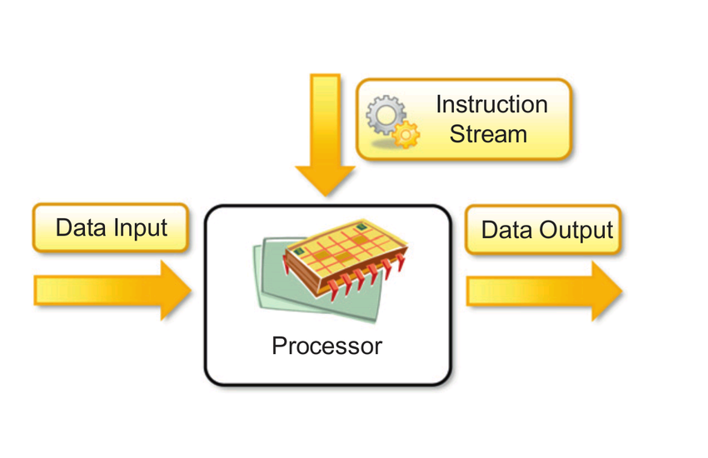
Single Instruction Single Data (SISD)
SISD computing system is a uniprocessor machine capable of executing a single instruction, which operates on a single data stream.
In SISD, Machine instructions are processed sequentially in a computers which is called as sequential computers.
SISD systems are IBM-PC, Macintosh, Workstation, etc.

Slide 31
Single Instruction Multiple Data (SIMD)
SIMD computing system is a multiprocessor machine capable of executing the same instruction on all the CPUs, but operating on different data streams.
Its well suited for scientific computing that involves lots of vector and matrix operations. The statements is given as
Ci = Ai * Bi
In that vector A and B are divided into multiple sets (N Sets for N PE systems).(PE – Processing Elements)
SIMD systems are CRAY’s Vector processing machine, Thinking Machine’s cm*, etc.

Slide 32
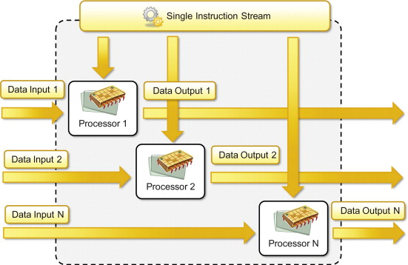
Single Instruction Multiple Data (SIMD)

Slide 33
Multiple Instruction Single Data (MISD)
MISD computing systems is a multiprocessor machine capable of executing different instructions on different PEs, but all of them operating on the same data-set.
Y = sin(x) + cos(x) + tan(x)
It performs different operations on the same data set.
This model is not useful for most of the applications, only a few machines are built, but none of them are available commercially.

Slide 34
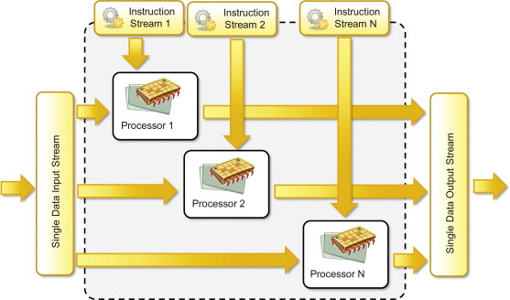
Multiple Instruction Single Data (MISD)

Slide 35
Multiple Instruction Multiple Data (MIMD)
MIMD is a multiprocessor machine capable of executing multiple instructions on multiple data sets.
Each PE in the MIMD has separate instructions and data streams, its well suited for all kind of applications.
MIMD machines are broadly categorized into two categories.
Shared Memory MIMD
Distributed Memory MIMD

Slide 36
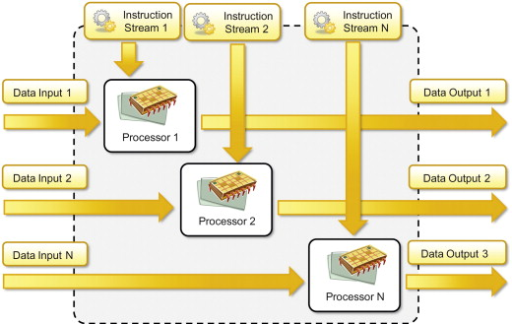
Multiple Instruction Multiple Data

Slide 37
Shared Memory MIMD machines
Shared Memory MIMD model, all the PEs are connected to a single global memory and they all have access to it.
System based on this model are also called tightly-coupled multiprocessor systems.
Modifications of the data stored in the global memory by one PE is visible to all other PEs.
Silicon Graphics machines and Sun/IBMs SMPs (Symmetric Multi-Processing).

Slide 38
Distributed Memory MIMD Machine
In Distributed Memory MIMD machine, each PEs have a local memory.
System based on this model called as loosely coupled microprocessor systems.
Communication between the PEs are taken care by IPC (Inter Process Communication channel)
Network Connection as TREE, MESH , CUBE, etc.
Each PE operates asynchronously and if synchronization among tasks is necessary, they do exchanging messages between them.

Slide 39
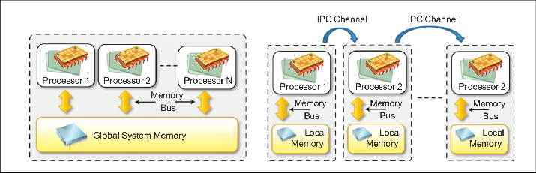

Slide 40
3. Approaches to Parallel Programming
A sequential program is one which runs on a single processor and has a single line of control.
To make many processors collectively work on a single program, the program must be divided into smaller independent chunks to perform individual task.
A wide variety of parallel programming approaches are available well suited for task-level parallelism (divide and conquer).
Data Parallelism
Process Parallelism
Farmer and Worker model (Master and Slave Model)

Slide 41
4. Levels of parallelism
Levels of parallelism are depends on the lumps of code that are potential candidate for parallelism.
These approaches have common goal to boost processor efficiency by hiding latency.
The idea is to execute concurrently two or more single-threaded applications, such as compiling, text formatting, database searching, and device simulation.
Grain size | Code item | Parallelized by
Large | Separate and heavy weight | Programmer
Medium | Function or procedure | Programmer
Fine | Loop or Instruction block | Parallelizing compiler
Very fine | Instruction | Processor

Slide 42
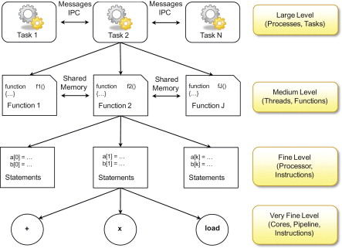

Slide 43
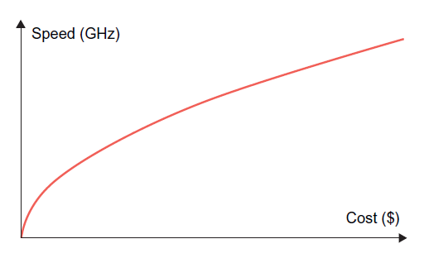
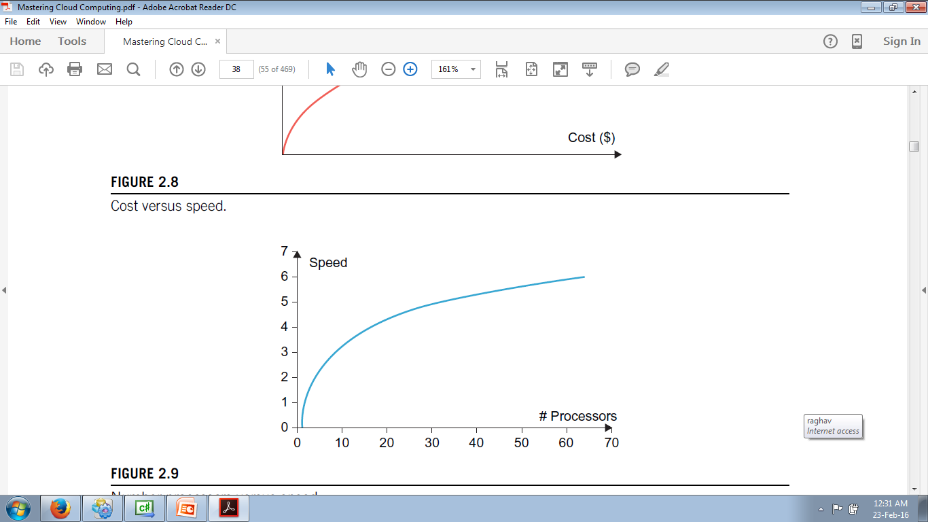
5. Laws of caution
Law of caution helps to understand how much benefit an application or a software system can have from parallelism.
By considering the experience in designing and implementing such systems.
Speed of computation is proportional to the square root of system cost; They never increases linearly. i.e. faster the system more expense to increase its speed.
Speed-up by a parallel computer increases as the logarithm of the number of processors; (i.e. y = k*log(N))
a)Cost versus speed b) Number of processors versus speed-up

Slide 44
Elements of Distributed Computing
Definition
Components of a Distributed System
Architectural Styles for Distributed Computing
3.1 Components and Connectors
3.2 Software Architectural Styles
3.2.1 Data-centered Architectures
3.2.2 Data-flow architectures
3.2.3 Virtual machine architectures
3.2.4 Call and Return Architectures
3.2.5 Architectural Styles based on Independent Components

Slide 45
Elements of Distributed Computing
3.3 System Architectural Styles
3.3.1 Client-Server
3.3.2 Peer-to-Peer
4. Models for Inter-Process Communication
4.1 Message-based communication
4.1.1 Message Passing
4.1.2 Remote Procedure call (RPC)
4.1.3 Distributed Objects
4.1.4 Distributed Agents and Active Objects
4.2 Models for Message-based communication
4.2.1 Point-to-point Message Model
4.2.2 Publish-subscribe Message model
4.2.3 Request-Reply Message Model

Slide 46
Definition
Coulouris et al.
“A distributed system is one in which components located at networked computers communicate and coordinate their actions only by passing messages”
Tanenbaum et al.
“A distributed system is a collection of independent computers that appears to its users as a single coherent system”

Slide 47
2. Components of a Distributed System
It is the result of the interaction of several components that traverse the entire computing stack from hardware to software.
It merges from the collaboration of several elements that by working together give to the user the illusion of a single coherent system.
Bottom layer, computer and network hardware constitute the physical infrastructure; these components are directly managed by the operating system for
Inter-process communication,
Process scheduling and management
Resource management

Slide 48
2. Components of a Distributed System (Cont…)
Two layers (Hardware and operating system) become the platform on top of which specialized software is deployed to turn a set of networked computers into a distributed system.
At operating system level, inter-process communication services are implemented on top of standardized communication protocols such as TCP/IP and UDP.
The middle layer leverages such services to build a uniform environment for the development and deployment of distributed applications.
It offers the own protocols, data formats, and programming language or frameworks for the development of distributed applications.
The top of the distributed system stack is represented by the application and services designed and developed to use the middleware.

Slide 49






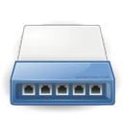


2. Components of a Distributed System (Cont…)
Frameworks for distributed programming
Applications
Middleware
IPC primitives for control and data.
Operating System
Networking and Parallel Hardware
Hardware

Slide 50
3. Architectural Styles for distributed computing
The middleware layer is the one that enables distributed computing, as it provides a coherent and uniform runtime environment for applications.
It helps in understanding and classifying the organization of software systems in general and distributed computing in particular.
“Architectural styles are mainly used to determine the vocabulary of components and connectors that are used as instances of the style together with a set of constraints on how they can be combined.”
Architectural styles are two major classes:
Software Architectural styles : Relates to the logical organization of the software.
System Architectural styles: styles that describe the physical organization of distributed software systems in terms of their major components.

Slide 51
Software Architectural Styles
Software architectural styles are based on the logical arrangement of software components.
They are helpful because they provide an intuitive view of the whole system, despite its physical deployment.
They also identify the main abstractions that are used to shape the components of the system and the expected interaction patterns between them.

Slide 52
Software Architectural Styles
Category | Most common Architectural Styles
Data Centered | Repository Blackboard
Data Flow | Pipe and filter Batch Sequential
Virtual Machine | Rule based Interpreter
Call and return | Main program and subroutine call/top-down systems Layered Systems
Independent Components | Communicating Processes Event Systems

Slide 53
Data Centered Architectures
Identify the data as the fundamental element of the software system, and access to shared data is the core characteristics of the data-centered architectures.
Within the context of distributed and parallel computing systems, integrity of data is overall goal for such systems.
The repository architectural style is the most relevant reference model in this category. It is characterized by two main components – the central data structure, which represents the current state of the system, and a collection of independent component, which operate on the central data.
In particular repository based architectures differentiate and specialize further into subcategories according to the choice of control discipline to apply for the shared data structure. Of particular interest are databases and blackboard systems.
In the repository systems, the dynamics of the system is controlled by independent components, which by issuing an operation on the central repository, trigger the selection of specific processes that operate on data.

Slide 54
Black board Architectural Style
The black board architectural style is characterized by three main components:
Knowledge sources : These are entities that update the knowledge base that is maintained in the black board.
Blackboard : This represents the data structure that is shared among the knowledge sources and stores the knowledge base of the application.
Control: The control is the collection of triggers and procedures that govern the interaction with the blackboard and update the status of the knowledge base.

Slide 55
Data Flow Architectures
Access to data is the core feature, data-flow styles explicitly incorporate the pattern of data-flow, since their design is determined by an orderly motion of data from component to component, which is the form of communication between them.
Styles within this category differ in one of the following ways: how the control is exerted, the degree of concurrency among components, and the topology that describes the flow of data.
Batch Sequential: The batch sequential style is characterized by an ordered sequence of separate programs executing one after the other. These programs are chained together by providing as input for the next program the output generated by the last program after its completion, which is most likely in the form of a file. This design was very popular in the mainframe era of computing and still finds applications today. For example, many distributed applications for scientific computing are defined by jobs expressed as sequence of programs that, for example, pre-filter, analyze, and post process data. It is very common to compose these phases using the batch sequential style.
Pipe-and-Filter Style: It is a variation of the previous style for expressing the activity of a software system as sequence of data transformations. Each component of the processing chain is called a filter, and the connection between one filter and the next is represented by a data stream.

Slide 56
Comparison between Batch Sequential and Pipe-and-Filter Styles
Batch Sequential | Pipe-and-Filter
Coarse grained | File grained
High latency | Reduced latency due to the incremental processing of input
External access to input | Localized input
No concurrency | Concurrency possible
Non interactive | Interactivity awkward but possible

Slide 57
Virtual Machine architectures
The virtual machine class of architectural styles is characterized by the presence of an abstract execution environment ( generally referred as a virtual machine) that simulates features that are not available in the hardware or software.
Applications and systems are implemented on top of this layer and become portable over different hardware and software environments.
The general interaction flow for systems implementing this pattern is – the program (or the application) defines its operations and state in an abstract format, which is interpreted by the virtual machine engine. The interpretation of a program constitutes its execution. It is quite common in this scenario that the engine maintains an internal representation of the program state.

Slide 58
Virtual machine architectures contd…
Popular examples within this category are rule based systems, interpreters, and command language processors.
Rule-Based Style:
This architecture is characterized by representing the abstract execution environment as an inference engine.
Programs are expressed in the form of rules or predicates that hold true.
The input data for applications is generally represented by a set of assertions or facts that the inference engine uses to activate rules or to apply predicates, thus transforming data.
The examples of rule-based systems can be found in the networking domain: Network Intrusion Detection Systems (NIDS) often rely on a set of rules to identify abnormal behaviors connected to possible intrusion in computing systems.
Interpreter Style: The presence of engine to interpret the style.

Slide 59
Call and return architectures
This identifies all systems that are organized into components mostly connected together by method calls.
The activity of systems modeled in this way is characterized by a chain of method calls whose overall execution and composition identify the execution one or more operations.
There are three categories in this
Top down Style : developed with imperative programming
Object Oriented Style: Object programming models
Layered Style: provides the implementation in different levels of abstraction of the system.

Slide 60
Definition

Slide 61
Definition

